Slide 1
M2

Slide 2
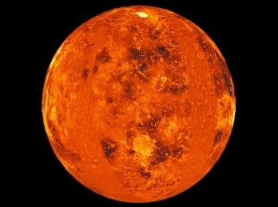
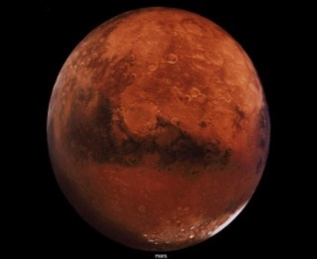
AIR
Let us study these abiotic components in detail in order to understand their role in sustaining life on Earth
It is a mixture of gases like nitrogen, oxygen, carbon dioxide and water vapour
O₂
O₂
CO₂
N₂
N₂
N₂
CO₂
O₂
CO₂
The composition of air is the result of life on earth
CO₂
H₂O
CO₂
H₂O
N₂
O₂
In planets such as Venus and Mars, where no life is known to exist, the major component of the atmosphere is found to be carbon dioxide(95 to 97%)

Slide 3
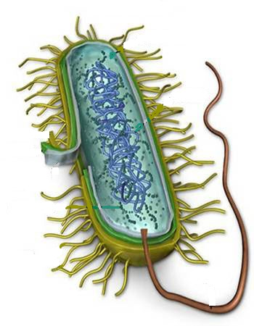
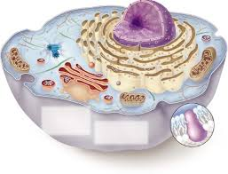
Eukaryotic cells and many Prokaryotic cells use oxygen to break down glucose molecules and get energy
Eukaryotic cells
Prokaryotic cells
O₂
CO₂
O₂
CO₂
CO₂
CO₂
CO₂
CO₂
E
E
E
E
E
E
This results in the production of carbon dioxide

Slide 4
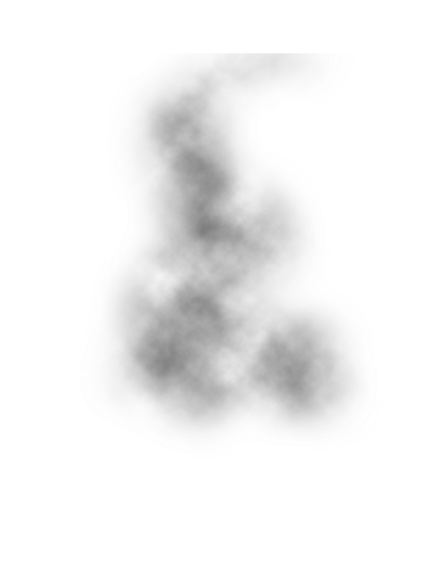
Another process which results in the consumption of oxygen and the concomitant production of carbon dioxide is combustion.
O₂
Combustion
CO₂

Slide 5

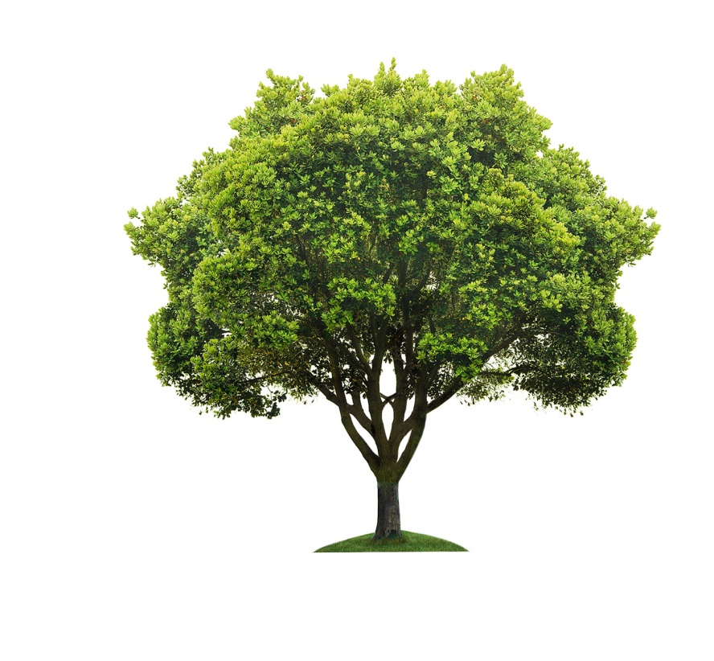
Despite this, the percentage of carbon dioxide in our atmosphere is mere fraction of a percent because carbon dioxide is ‘fixed’ in 2 ways
Photosynthesis
CO₂
Glucose
Green plants convert carbon dioxide into glucose in the presence of Sunlight.

Slide 6
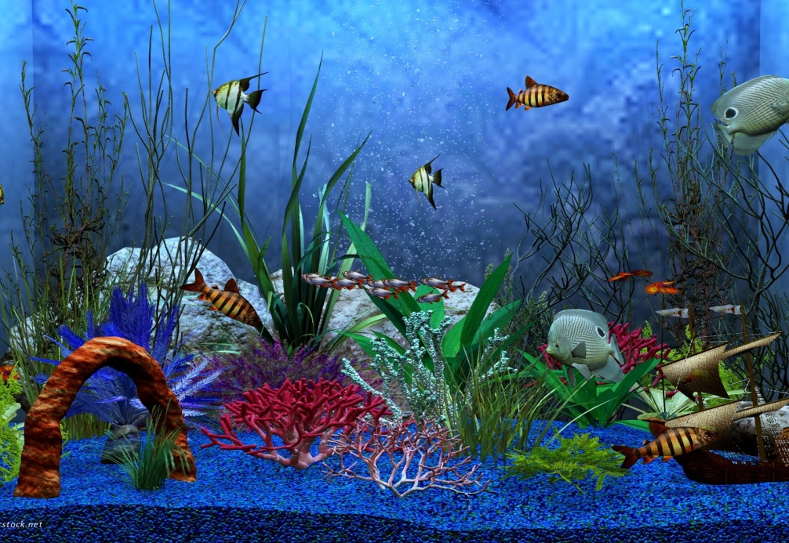
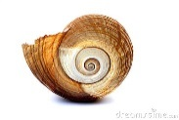

Despite this, the percentage of carbon dioxide in our atmosphere is mere fraction of a percent because carbon dioxide is ‘fixed’ in 2 ways
Marine animals
Marine animals use CO₂ as carbonates dissolved in sea water to make their shells.
CO₂
CO₃

